Slide 1









Doctor Who Guide Analysis
By Bernadette Slack
Example majors – Psychology, Marketing, Communications
Image retrieved from https://www.doctorwho.tv/

Slide 2
Background
My data set was acquired from https://www.kaggle.com/jeanmidev/doctor-who, which acknowledges that it acquired the data for the multiple sets they’ve compiled from multiple sites such as IMDB, http://www.chakoteya.net/DoctorWho/ , and https://guide.doctorwhonews.net/info.php?detail=ratings&type=date. This data set contains the number of views (by millions), and an appreciation index which was compiled by IMDB as a means of conveying the popularity by episode.
Is it possible that the appreciation index would be higher for the new run of Doctor Who than it was for the original (or for clarities sake “old”) run.
Is it possible that the same appreciation index gets larger as the viewership increases?

Slide 3
Research Question I and Hypothesis I
Is the average rating of the old run less than that of the new run?
Null Hypothesis – The average rating of the old run and the new run are equal.
Alternative Hypothesis – The average rating of the old run is less than the new run.

Slide 4
Method I
The data set that was chosen contains 852 episodes of Doctor Who. Of these episodes, 801 belonged to the old run, and 51 belonging to the new run. The variables for the first research question are the appreciation index – the measure used by IMDB to determine the popularity of each episode. They were sorted by old run and new run. Some episodes on the old run unfortunately do not have an appreciation index, these episodes were not included in the analysis. Since most of the data used for this analysis was gathered from IMDB a professional TV/Movie data source, it is believed that these statistics are valid for the purpose they are being used.
Since it is being hypothesized that the old run has a lower appreciation index than the new run, a left-tailed , independent samples t-test was used.

Slide 5
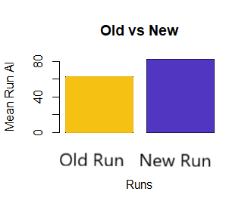
Test 1 results
An independent-samples t-test was conducted to compare the appreciation indices of the old run and the new run.
There was a significant difference in the appreciation index of the old run (M = 62.85, SD = 12.59) and the appreciation index of the new run (M= 82.31, SD = 1.59) condition at the significance level of .05; t(622) = -3.74,
p < 0.001.

Slide 6
Discussion of Results I
The results of the analysis showed that there was indeed a significant difference in the appreciation index for the old run and the new run.
This could very well be an indicator that the average appreciation is higher on the new run because of its availability, comparatively the distribution of media is significantly grander now than it was between 1963 – 1980. Therefore, because it is easier not only to view new episodes but also for the general public to log into IMDB and vote on an episode. This may indicate that either the general viewer is less likely to view episodes from the original run, or that they are less likely to be motivated to rate the episode,
In application, this could be pertinent to various rating companies as an indicator of viewer trends.

Slide 7
Research Question II and Hypothesis II
Is the appreciation index dependent on the amount of views, therefore, does the number of views predict a higher appreciation index?
Null Hypothesis – There is no linear relationship between the amount of views and the appreciation index.
Alternative Hypothesis – There is a linear relationship between the amount of views and a higher appreciation index.

Slide 8
Method II
The data set chosen was contains 852 episodes of Doctor Who. Of these episodes, 801 belonged to the old run, and 51 of the new run. The variables for the first research question are the appreciation index – the measure used by IMDB to determine the popularity of each episode. Some episodes on the old run unfortunately do not have an appreciation index, these episodes were not included in the analysis. The other variable is the number of views in the millions, this data was also compiled using IMDB. Since most of the data used for this analysis was gathered from IMDB a professional TV/Movie data source, it is believed that these statistics are valid for the purpose they are being used.

Slide 9
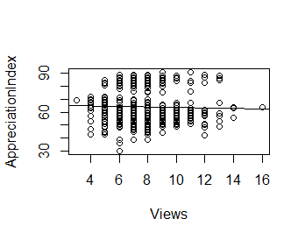
Test II results
A simple linear regression was conducted to predict the appreciation index based on the number of views (represented in the millions). A not significant regression equation was found (F(1, 624)) = 0.6122, p = 0.4343, with an R² of 0.00981. The predicted appreciation index 66.006 + 0.205x, where x is the number of views (shown in the millions).

Slide 10
Discussion of Results II
Surprisingly, there was little to no relationship between the amount of views and the appreciation index.
Since there is no relationship between the two variables, it is clear, that the appreciation index is not dependent on the amount of views.
As was stated in the method, there are around 200 episodes from the original run that do not have an appreciation index at all.

Slide 11
Sources
D., Jean-Michel (2020, November). Doctor Who. Kaggle. https://www.kaggle.com/jeanmidev/doctor-who
BBC Image. Image retrieved from https://www.doctorwho.tv/

